Slide 1
Omnimagnet Mind Map
Mohamed Ghori:
www.linkedin.com/in/mohamedghori , https://github.com/mghorireserach
Aaron Becker:
http://www.ece.uh.edu/faculty/becker
Inspired by Dr. Jake Abbott:
http://www.telerobotics.utah.edu/index.php/Research/Omnimagnets

Slide 2
Mind Map
MAIN
Master Function to run entire Omnimagnet Simulation.
SHAPE
Trajectory Shape Function that rolls the ball through a specific trajectory. Using CNTRL it returns VISUAL & DATA
CNTRL
Trajectory Following Function that uses MATH to output DATA & Visual
MATH
Math functions(ie. rotx.m : rotation about the x-axis )
VISUAL
Visualization of the tool’s simulated trajectory
DATA
Solenoid Current Values
MAIN
SHAPE
CNTRL
MATH
Data
VISUAL

Slide 3
MAIN
MAP
SHAPE
MAIN( type, x0, y0, phi, psi, ShapeSize, T, dt, speed, ballsize )
The MAIN function is the highest level function where the rollBallInRectangle or rollBallInCircle function and the playback function is called, as well as functions that clears all the figures & data. The main function has 10 parameters. However, it can be called with 1,6,9, or 10 arguments.

Slide 4
SHAPE
MAP
CNTRL
rollBallInRectangle ( x0, y0, phi, psi, ShapeSize, T, dt, speed, ballsize)
rollBallInCirlce ( x0, y0, phi, psi, ShapeSize, T, dt, speed, ballsize )
Playback ( currx, curry, currz,wHb )

Slide 5
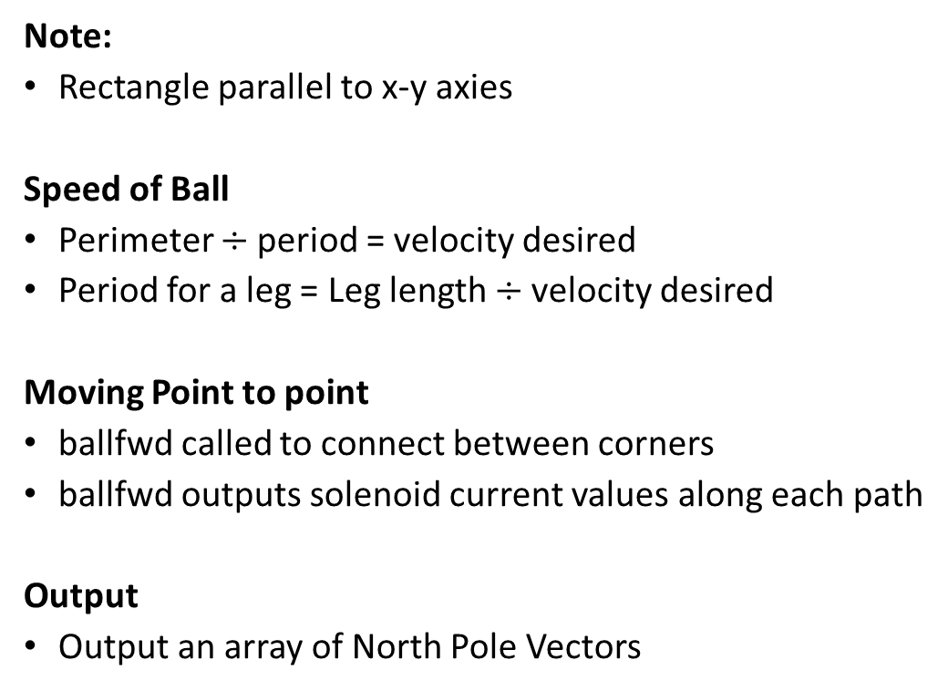
rollBallInRectangle
SHAPE
Note:
Rectangle parallel to x-y axies
Speed of Ball
Perimeter $÷$period = velocity desired
Period for a leg = Leg length $÷$velocity desired
Moving Point to point
ballfwd called to connect between corners
ballfwd outputs solenoid current values along each path
Output
Output an array of North Pole Vectors
Velocity
Magnet
N

Slide 6
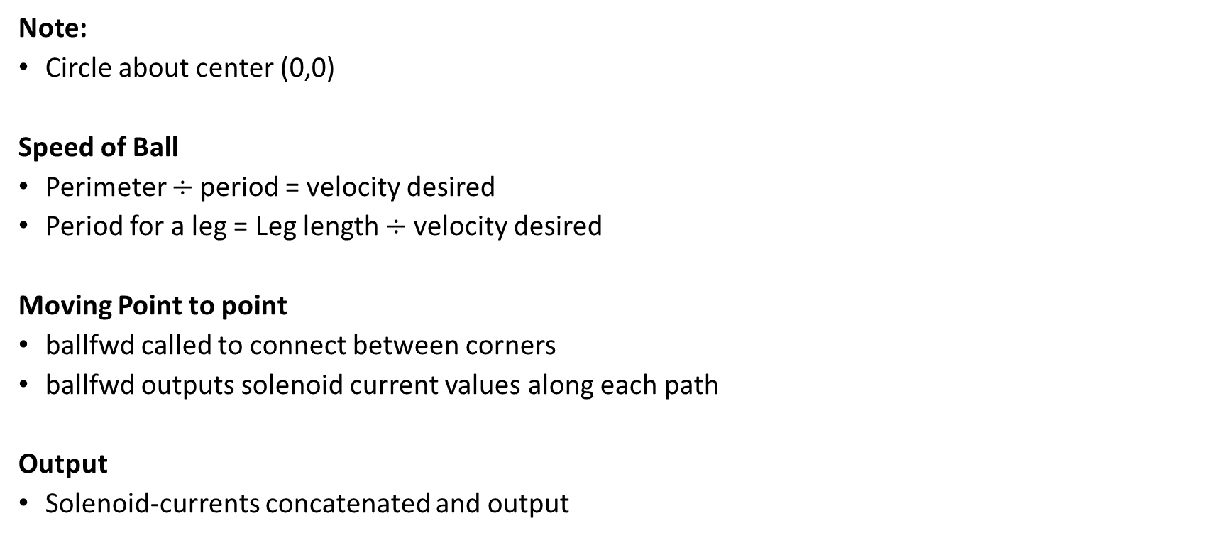
rollBallInCircle
SHAPE
Note:
Circle about center (0,0)
Speed of Ball
Perimeter $÷$period = velocity desired
Period for a leg = Leg length $÷$velocity desired
Moving Point to point
ballfwd called to connect between corners
ballfwd outputs solenoid current values along each path
Output
Solenoid-currents concatenated and output
Velocity
Magnet
N

Slide 7
playback
SHAPE
Moving Point from Orientation to Orientation
The North-Pole vectors that were recorded are used with fwdcurrent to rotate between such that the north pole coincides with the final north pole vector.
Output
A visual of the ball tool following this path
Velocity
Magnet
N

Slide 8
CNTRL
MAP
MATH
Ballfwd ( p0, pf, wHb, T, dt, speed, ballsize )
Fwdcurrent ( I0, If, wHb, T, dt, speed, ballsize )
fwdMagneticField ( currx, curry, currz, x, y )
inverseMagneticField ( x, y, phi, psi )

Slide 9
ballfwd
CNTRL
Note:
Rolling about Magnetic Field y-Axis
Method
Find Goal:
Rotate about world z-axis
T(ballfwd Period)/4
Return current for orientation snapshots at “0 : dt :T/4”
Roll to Goal:
Rotate about Magnetic Field y-Axis
3T/4
Return North pole vectors for orientation snapshots at “T/4 : dt : T”
Output
An array of North pole vectors from the orientation snapshots of the ball’s rotation

Slide 10
fwdcurrent
CNTRL
Note:
Doesn’t work with magnetic field currently
Method:
Two consecutive orientations are found using two consecutive north pole vectors
The orientations are decomposed in terms of rotation in the xy-plane(phi) & the xz-plane(psi)
Dr. Becker’s “RollAnyPointOnTheSphereToAnyDesiredLattitudeLongitudeCoordina is used to find the rotation matrix, direction, and translation (point2pointroll)
Output:
Final Position and Orientation (pf, wRb)

Slide 11
fwdMagneticField(Unused)
CNTRL
Note:
The equations are not linear and there fore when back tracking one does not find the same vectors
Input:
Electric Current for each solenoid (currx,curry,currz)
Current Position of Ball (x,y)
EQN:
Current put in as a vector into equation from Jake Abbott
Output:
Magnetic Field Vector Tangent to Magnetic Field at the Tool

Slide 12
inverseMagneticField(Unused)
CNTRL
Input:
Orientation of the magnetic field at the Tool (phi,psi)
Current Position of Ball (x,y)
EQN:
Magnetic Field vector constructed using orientation with a magnitude of 100
Magnetic Field vector put into equation from Jake Abbott
Output:
Electric Current for each solenoid [currx; curry; currz]

Slide 13
MATH
MAP
VISUAL
piont2piontroll (vect1,vect2)
rotTime (deltheta,omega0, alph)
Rot_in_phipsi (R)
Vect2skew (vector)
Axis2rot (Axis,Angle)
rot2Axis (R)
rot2quat(R)
quatmult (q1,q2)
Rotx (roll)
Roty (pitch)
Rotz (yaw)

Slide 14
point2piontroll
MATH
Implemented Dr. Becker's Code: "Roll Any Point on the Sphere to any desired Latitude-Longitude Coordinates with one Straight-Line Roll“

Slide 15
rotTime
MATH
Uses kinematic th = th0 + w0*t + 0.5*alph*t^2 to calculate the time required to reach a certain position using a given angular acceleration(from torque)

Slide 16
Rot_in_phipsi
MATH
This function returns the phi (angle of vector with the x-axis in x-z plane) and psi (angle of vector the x-axis in the y-x-plane )

Slide 17


vect2skew
MATH
Converts from a vector its skew symmetric matrix form
Skew-Symmetric Form
Unit-Vector
$$\left[\begin{matrix}0 & −z & y \\ z & 0 & −x \\ −y & x & 0\end{matrix}\right]$$
$$\left[\begin{matrix}x \\ y \\ z\end{matrix}\right]$$

Slide 18
axis2rot
MATH
Converts from an axis angle notation of a rotation to a rotation matrix in 3D Euclidean space

Slide 19
rot2axis
MATH
Converts from a rotation matrix to an axis angle notation for rotation in 3D Euclidean space

Slide 20
rot2quat
Converts a rotation matrix into its quaternion form

Slide 21
quatmult
A function that multiplies two quaternions

Slide 22
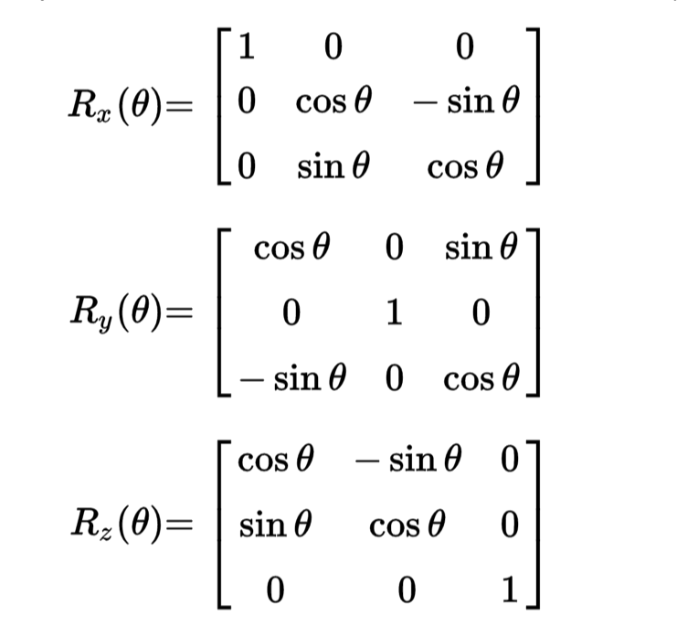
rotx roty rotz
MATH
Basic Euler rotation matrix equations (roll, pitch, yaw)

Slide 23
VISUAL
MAP
DATA
plot_ball (ballsize, pos,R,dt,speed)
Showmagfield (currx,curry,currz,p0)
Magfield (I)

Slide 24
plot_ball
VISUAL
First Call creates a figure of equal axis at a corner view
Draws a transparent sphere
Draws a quiver along the z-axis and y-axis of the magnetic field
Then transforms it using a homogeneous matrix (MATLAB:hgtransform)

Slide 25
Showmagfield(Not Functional)
Draws a magnetic field line using a series of 200 segments (quivers) from head to tail

Slide 26
magfield
Draws the magnetic field based on the solenoid current
NOTE: Does not use meshgrid
NOTE: The entire field is pointing in one direction (which may be incorrect)

Slide 27
DATA
MAP
Solenoid Current Data is put into an excel file

